Slide 1
QUEUE

Slide 2
What is a Queue
The Queue<T> is a Generic collection that stores elements in FIFO style (First In First Out). The C# Language Includes both the Generic Queue<T> and Non-Generic Queue collection classes. It is recommended by Microsoft to use the Generic Queue<T> Collection class as it is type-safe and boxing and unboxing it not required.
The Generic Queue in C# is a collection class that works on the principle of First In First Out (FIFO) and this class is present in System.Collections.Generic namespace. That means we need to go for Generic Queue Collection when we need First In First Out (FIFO) access to items.
In Generic Queue Collection, we can store duplicate elements. A Queue can also accept null as a valid value for a reference type.

Slide 3

How to Create a Generic Queue<T> Collection
The Generic Queue<T> Collection Class in C# provides the following three constructors to create an instance of the Generic Queue<T> class.
Queue(): It is used to initialize a new instance of the Generic Queue class that is empty and has the default initial capacity.
Queue(IEnumerable<T> collection): It is used to initialize a new instance of the Generic Queue class that contains elements copied from the specified collection and has sufficient capacity to accommodate the number of elements copied. Here, the parameters collection specifies the collection whose elements are copied to the new Generic Queue. If the collection is null, then it will throw ArgumentNullException.
Queue(int capacity): It is used to initialize a new instance of the Generic Queue class that is empty and has the specified initial capacity. Here, the parameter capacity specifies the initial number of elements that the Queue can contain. If capacity is less than zero, then it will throw ArgumentOutOfRangeException.

Slide 4
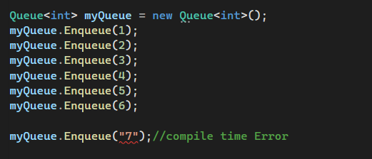
How to Add Elements into a Queue<T> Collection
If you want to add elements to a generic queue collection in C#, then you need to use the following Enqueue() method of the Queue<T> class.
Enqueue(T item): The Enqueue(T item) method is used to add an element at the end of the queue. Here, the parameter item specifies the element to add to the queue. The value can be null for a reference type i.e. when T is a reference type.

Slide 5
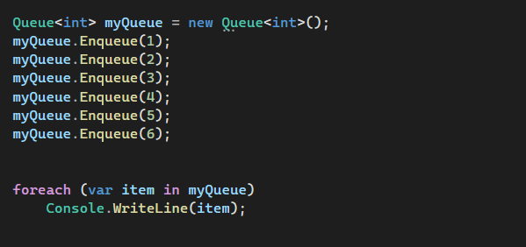

How to access a Generic Queue Collection
We can access all the elements of the Generic Queue collection in C# using a for each loop as follows.
Note: You cannot use a for loop to access the elements of a generic queue collection and the reason for this is the Generic Queue collection class does not have any integer indexer.

Slide 6
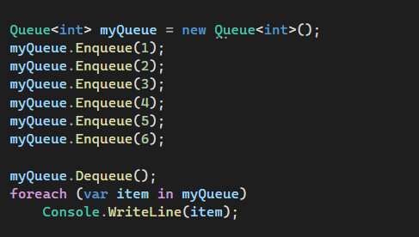

How to Remove Elements from a Generic Queue<T> Collection
In Queue, the Elements which is added first will be the element to be removed first. That means we are allowed to remove elements from the beginning of the queue. The Generic Queue Collection Class in C# provides the following two methods to remove elements.
Dequeue(): This method is used to remove and return the object at the beginning of the Generic Queue. It returns the Object (element) removed from the beginning of the Generic Queue. If the Queue is empty, then it will throw InvalidOperationException.
Clear(): This method is used to remove all objects from the Generic Queue.

Slide 7
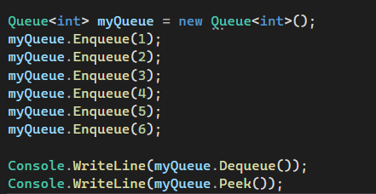

How to Get the First Element from the Generic Queue
The Generic Queue<T> Collection Class in C# provides the following two methods to get the first element of the queue collection
Dequeue(): The Dequeue() method of the Queue class is used to Remove and return the object from the beginning of the Queue. That means it returns the object that is removed from the beginning of the Generic Queue. If the queue is empty, it will throw InvalidOperationException
Peek(): The peek() method of the Queue class is used to return the object at the beginning of the Queue without removing it. That means it returns the object from the beginning of the Queue. If the queue is empty, then it will throw InvalidOperationException.

Slide 8
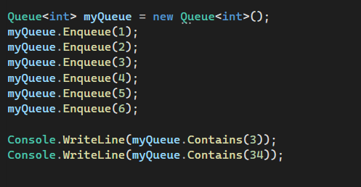

How to check whether an Element Exists or Not in the Generic Queue<T> Collection
If you want to check whether an element exists or not in the Generic Queue<T> Collection, then you need to use the following Contains() method provided by the Generic Queue Class in C#. Even, you can also use this method to search for an element in the given stack.
Contains(T item): The Contains(T item) method is used to determine whether an element exists in the generic queue or not. It returns true if the item is found in the generic queue; otherwise, false. Here, the parameter item specifies the element to locate in the queue. The value can be null for a reference type.

Slide 9
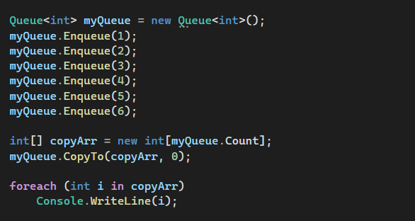
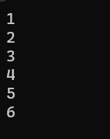
How to Copy a Generic Queue Collection to an Existing Array
In order to copy a Generic Queue Collection to an Existing Array in C#, we need to use the following CopyTo method of the Generic Queue Collection Class.
CopyTo(T[] array, int arrayIndex): This method is used to copy the Generic Queue Collection Elements to an existing one-dimensional Array, starting at the specified array index. Here, the parameter array specifies the one-dimensional array that is the destination of the elements copied from the generic queue. The Array must have zero-based indexing. The arrayIndex parameter specifies the zero-based index in the array at which copying begins. If the parameter array is null, then it will throw ArgumentNullException. If the parameter index is less than zero, then it will throw ArgumentOutOfRangeException. If the number of elements in the source Generic Queue is greater than the available space from arrayIndex to the end of the destination array, then it will throw ArgumentException.

Slide 10
Generic Queue vs Non-Generic Queue
The Generic Queue<T> Collection Class is defined under System.Collections.Generic namespace where the Non-Generic Queue Collection Class is defined under System.Collections namespace.
The Generic Queue<T> Class in C# can only store the same type of elements whereas the Non-Generic Queue Class can store the same or different types of elements as it operates on the object data type.
In Generic Queue<T>, we need to define the type of elements that we want to store in the queue. On the other hand, in a Non-Generic Queue, there is no need to define the type of elements that we want to store in the queue because it operates on object data type i.e. we can store any type of data.
The Generic Queue<T> is type-safe whereas the Non-Generic Queue is not type-safe.

Slide 11
Generic Queue<T> Collection Class Summary
The following are some important points that you need to remember while working with Generic Queue Collection Class in C#.
The Queue Collection is used to store a collection of the same type of elements in a FIFO (First in, First out) manner, i.e., the element added first will be removed first.
As Queue<T> is a Generic Collection, so it comes under System.Collection.Generic namespace.
The Generic Queue<T> Collection stores elements of the specified type. It provides compile-time type checking and doesn’t perform boxing-unboxing because it is generic.
By using the Enqueue() method, we can add elements to a queue collection. Here, we cannot use collection-initializer syntax to add elements to a queue.
The Dequeue() method will remove and return the first element from the beginning of the queue.
The Peek() method will return the first inserted element of the queue without removing it from the collection.
Queue Collection is very useful to store temporary data in the First In First Out (FIFO) style, where you might want to delete an element after retrieving its value.

